Slide 1
“ABC – Accelerated Border Clearance”
An Innovative Idea by
Global Express Association (GEA)
Advisory Committee on Supply Chain Competitiveness (ACSCC)
June 23, 2015

Slide 2
“ABC” Clearance Model
Introduction
Smooth border facilitation is a critical component of international trade and has become a significant driver to economic growth.
Single Window is a positive step forward; however, it still leaves many border process issues unresolved.
The “ABC” model connects the dots on many of the new customs programs and provides a highly efficient and compliant clearance process.

Slide 3
“ABC” Clearance Model
The Basics
The “ABC” model replaces the current clearance processes being used by most countries around the world.
The foundation of the “ABC” model is based on a strong security program, supported by an intensive pre-certification of the entities, commodities, and the supply chain.
Companies volunteer to participate based on their willingness to meet the pre-certification requirements.
Border agencies cooperation is required.
The “ABC” model would not apply to occasional or one-time traders.

Slide 4
“ABC” Clearance Model
How It Works
Security programs (AEO, ACAS) are combined with facilitation programs (authorized trader, deferred payment).
Transactional controls for safety and revenue are replaced by pre-certification of entities and commodities and by account-based controls. Intel-based interventions remain.
1. Step: Pre-loading filing for security risk assessment, immediate release upon arrival.
2. Step: Duties and taxes are paid periodically with a periodic declaration summarizing all entries for the given period.

Slide 5
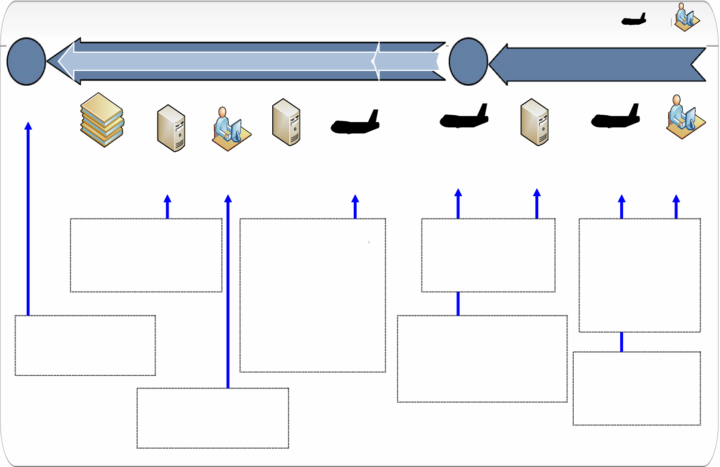
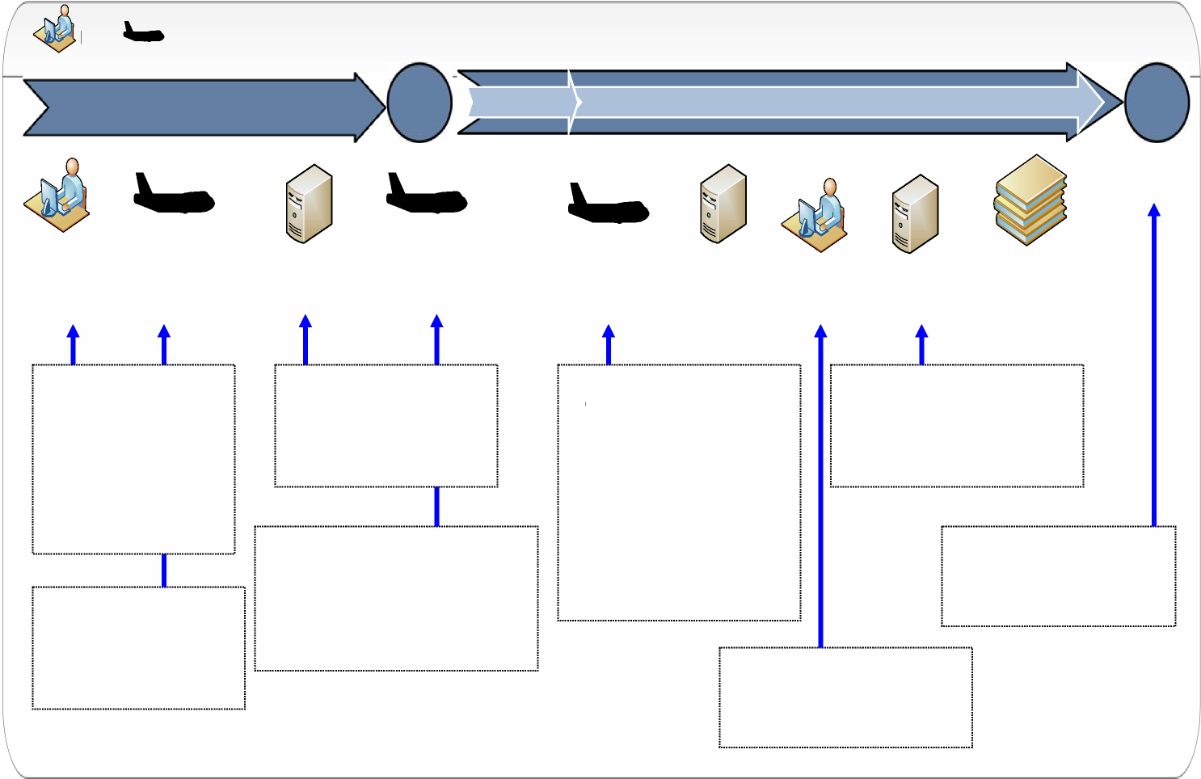

“ABC” Clearance Model
Phased Approach to Simplification of Clearance Process
Pick-up
Input Shipment Data
Targeting Systems
Flight Departure
Brokerage Process
Customs/
OGA
Flight Arrival/Release
Delivery
Clearance
Security
Safety Revenue
 | 1 | 2 | 3 | 4
Current Model 4 Steps | Security filing, e.g. ACAS | Pre-Arrival Entry Other Government | (Transactional) Agencies (OGA) Releases | Release and Clearance Payment 10 days
Single Window 3 Steps | Security filing, e.g. ACAS | Pre-Arrival Single Window processing - Other Government Agencies - Transactional Process |  | Release and Clearance Payment 10 days
“ABC” 2 Steps Advance Processing and Account Based Controls | Security filing, e.g. ACAS Authorized Trader Certification |  |  | Period Entry / Deferred payment

Slide 6
Accelerated Border Clearance (ABC)
Foundational Principals
Consistent with existing CBP policies and procedures
Connects dots of successful CBP programs
  C-TPAT
  Importer Self Assessment
  Centers of Excellence & Expertise
  Global Entry
  Foreign Trade Zones
Continues to show CBP’s leadership implementing innovative programs that enhance security, compliance, and improve trade facilitation
Model the way for other countries and global harmonization

Slide 7
“ABC” Clearance Model
Requirements for Participation
To qualify for acceptance in the program, a company must agree to participate in an individual country’s requirements, including:
  Supply chain security program based on the WCO SAFE Framework of Standards, e.g. Authorized Economic Operator (AEO).
  Self Assessment and Compliance Programs, e.g. authorized trader.
  Electronic filing of all relevant border clearance information.

Slide 8
Accelerated Border Clearance (ABC)
Benefits
MUTUAL BENEFIT FOR CBP AND TRADE
Provides balanced focus on security, compliance, and trade facilitation.
Reduces bottlenecks and holds at borders.
Improves compliance and reduces risk to government.
Reduces post entry activity.
Program is open to all companies; small, medium, and large.
CBP (and PGA’s)
Provides incentive for more companies to join C-TPAT and ISA.
Allows for greater focus on high risk shipments.
Provides efficiencies for staffing and planning.
Importers take on greater responsibility.
Helps facilitate compliance with IPR and consumer protection
Less compliance concerns and oversight of FTZ’s
TRADE
Return on investment/tangible benefits for participation in C-TPAT and ISA.
Reliability for supply chain.

